Slide 1

FIFA World Cup Historical Trends
Group Members: Elsa Figueroa | Nato Ebralidze | Muhammad Hassan | Myagmarsuren Budaasuren

Slide 2

Introduction

Slide 3
Overview
Booking Trends: Comparing between Winners & Non Winners Average
First Score: How many times did winner scored first vs non winners
Team Game or Individual Brilliance: Star Player Performance in a Winners and Non Winners team
Regional Winners: How often the host country was the winning country as well as determining the trend in consecutive winners
Penalty Kicks: Conversion Ration between winners & non winners

Slide 4
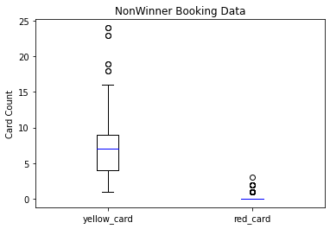
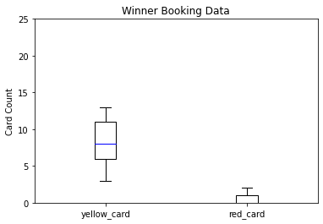
Booking Trends

Slide 5
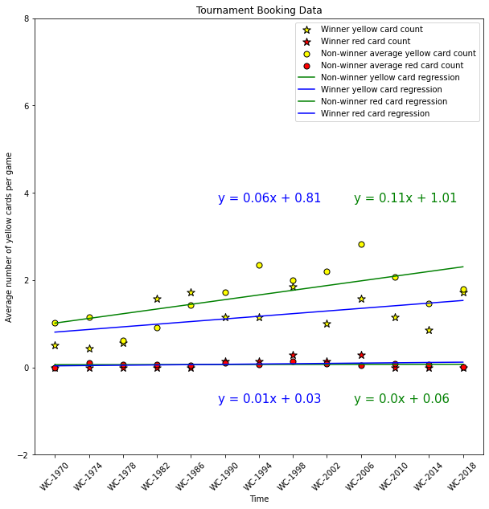
Booking Trends:
Over the years , average yellow card per game has been increased for both winners and non winners, but non- winners had higher increase than winners. P value is 0.03 .
In terms of red cards, winners and non-winners have identical trends and very stagnant over the years.

Slide 6
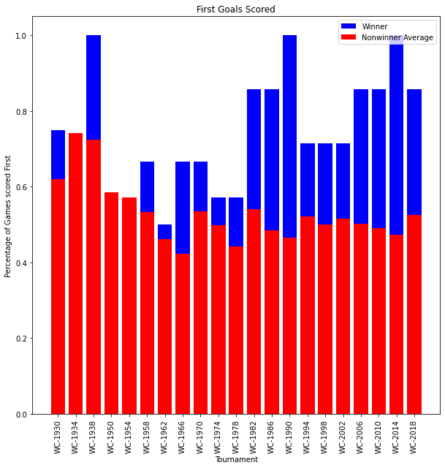
First Score
In the initial years of FIFA, although winners had tendency to have higher percentage of games scored first, the discrepancy has become significant since 1980s.

Slide 7
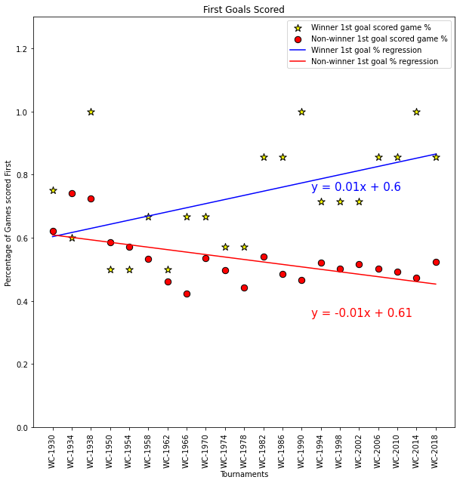
First Score
We can see that not only the gap between the 2 has increased over the years, winners have an increasing tendency and non winners have decreasing tendency. It shows that scoring first goal is a strong factor to become winner probably due to psychological effect.

Slide 8
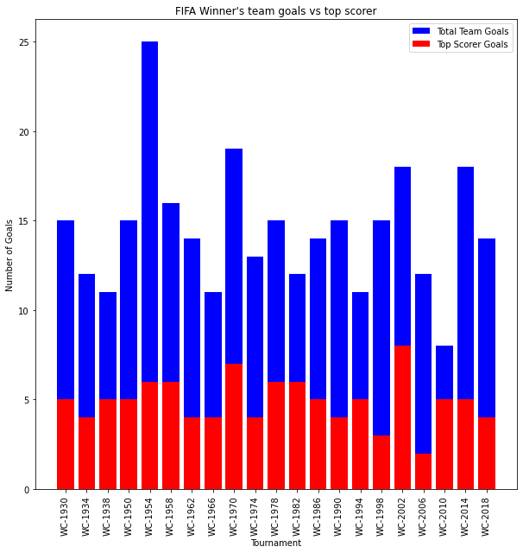
Team Game or Individual Brilliance
Highest scoring winning teams are especially diverse
Winning team top scorer never reach double digit goals

Slide 9
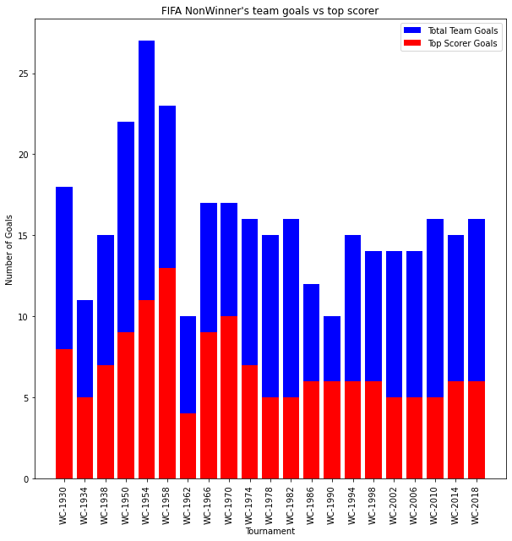
Winners have more diverse scoring squad than non winners.
Team Game or Individual Brilliance

Slide 10


Team Game or Individual Brilliance
The p-value of 0.0000018313860953475158 shows statistical significance

Slide 11
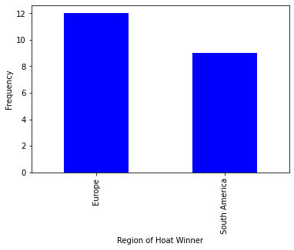
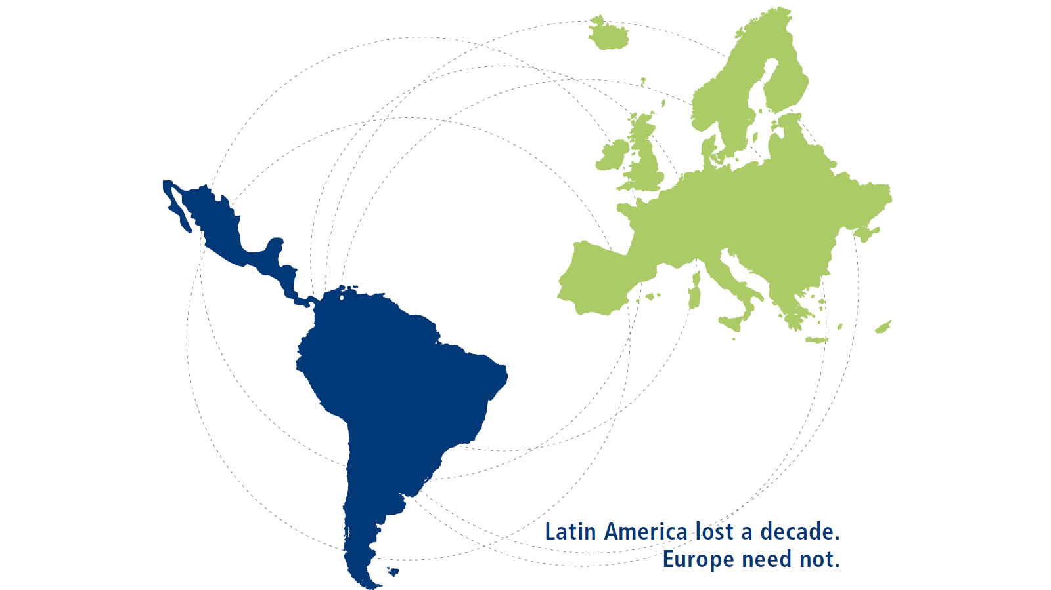
Regional Winners

Slide 12

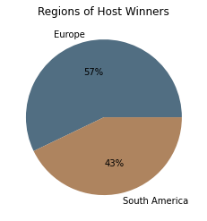
Regional Winners

Slide 13
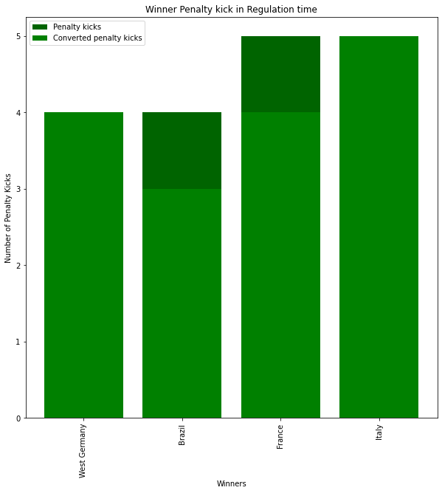
Penalty Kicks
The winning teams tend to have less number of penalty kicks received than non winning teams, but their conversion rate is higher than non winning teams

Slide 14
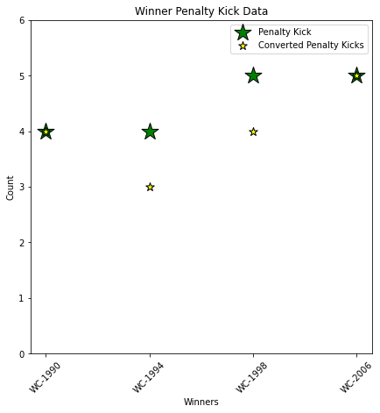
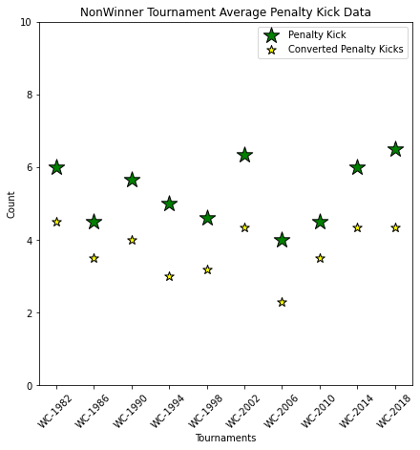

Slide 15

Conclusion
The summary of our findings are;
Winners have a tendency to receive less yellow cards per game on average than non-winners. In terms of red cards, there is no relevance.
Winners have been scoring the first goals at much higher percentage than non winners. The gap has been increasing over time.
Winners have more diverse scoring squad than non winners.
All the winners came from only 2 regions in the history of FIFA. ( Europe -57% , South America-43%)
Winners tend to have less number of penalty kicks received than non winning teams, but their conversion rate is higher than non winning teams.

Slide 16

Thank you

